Slide 1
Hotel Overbooking MDP
Goal: Maximize expected revenue (room revenue − overbooking penalty)
State (S): S = (t, n) where t=days left until check-in, n=current bookings
Action (A): Accept / Reject
Transition (t > 0):
Cancellations: c ~ Bin(n, 0.01), n_c = n − c
If Accept and n_c < 120:
with prob 0.8, n' = n_c + 1
with prob 0.2, n' = n_c
Else:
n' = n_c
If Reject: n' = n_c
Reward:
Intermediate (t > 0): R = 0
Terminal (t = 0): 100 · min(X, 100) − 250 · max(X − 100, 0), where X ~ Bin(n, 0.95)
Bellman Equation:

Slide 2
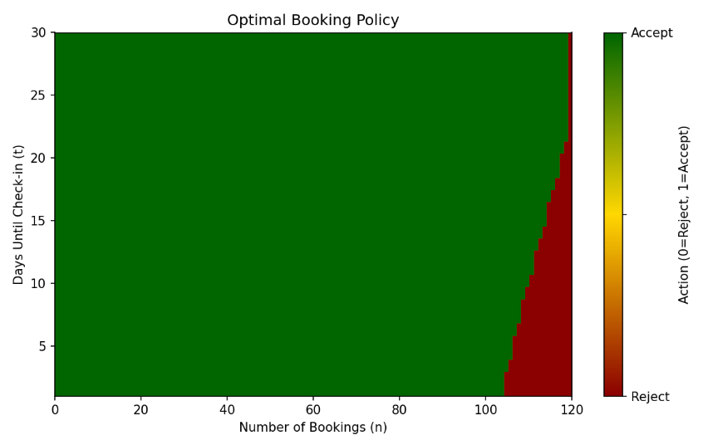
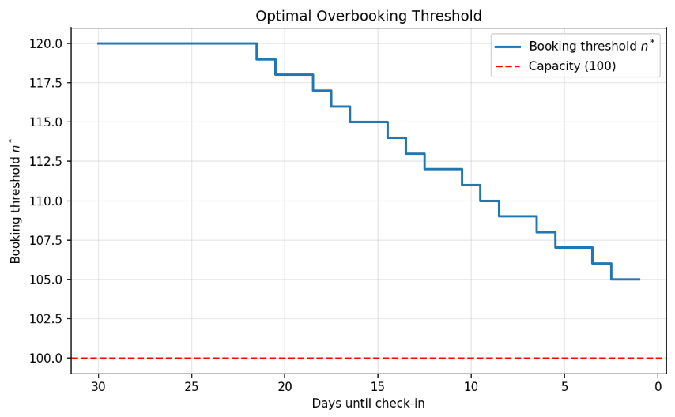
Policy Iteration Results
Parameters: Capacity=100, MaxOverbook=20, Price=100, Penalty=250
Policy (Sample Decisions):
Insights:
Early: accept aggressively
In the early days, the policy accepts bookings beyond capacity because cancellations and no-shows reduce the expected number of guests who actually arrive.
Near check-in: allow only slight overbooking
As the check-in day approaches, uncertainty decreases and the policy becomes more conservative, allowing only a few extra bookings.
Expected revenue from empty hotel: $1,978.28
The expected total profit starting from zero bookings is $1,978.28.
Days Left | 80 | 90 | 100 | 110 | 120
30
10
1

